Slide 1


Bridging the Gap Between Quantitative Rankings and Qualitative Assessment in University Sustainability: A Framework for Italian Universities
Presented by Edward King, Filipe Caçador, Natxo de la Rubia and Gennaro De Cicco
Tutti i diritti relativi al presente materiale didattico ed al suo contenuto sono riservati a Sapienza e ai suoi autori (o docenti che lo hanno prodotto). È consentito l'uso personale dello stesso da parte dello studente a fini di studio. Ne è vietata nel modo più assoluto la diffusione, duplicazione, cessione, trasmissione, distribuzione a terzi o al pubblico pena le sanzioni applicabili per legge

Slide 2
Motivation / Research Problem
Addressing the gap between quantitative university rankings and qualitative sustainability assessment
Increasing pressure on Higher Education Institutions (HEIs) from the UN 2030 Agenda and ESG expectations
Traditional university rankings primarily evaluate operational efficiency and academic productivity
Sustainability-focused rankings now exist, but often remain disconnected from institutional context and qualitative behaviour
Existing frameworks rarely bridge quantitative sustainability metrics with qualitative institutional interpretation
Our systematic review identified this methodological gap and motivated the development of an integrated mixed-method framework
Systematic Review
Identification of
“methodological schism”
Efficiency vs
Sustainability
Goal: Bridge the Gap
Notes:
Science is constantly evaluated
Evaluation determines careers, funding, and reputation
Used in:
University rankings
Journal publication decisions
Grant and fellowship selection
Peer review and citation metrics are the main tools
They act as indicators of scientific quality
Peer review seen as central social control in science

Slide 3
Research Aim & Framework
The author argues rankings are related to the following three bodies:
1
Data
Collection
Collect institutional efficiency and sustainability metrics
Use correlation analysis to identify potential cross-drivers
Classify universities using the efficiency-sustainability quadrant framework
Contextualise quantitative findings through NLP and web-scraped sustainability reporting
Provide interpretive institutional insights rather than causal conclusions
2
Correlation Analysis
3
Quadrant
Identification
4
Qualitative Assessment
“This framework is exploratory and interpretive. The goal is to contextualise relationships, not prove causation.”
Notes:
Citation databases owned by corporations
Publishing dominated by few companies
Rankings create global data industry
Knowledge becomes measurable
Knowledge becomes tradable
Knowledge becomes profitable
Rankings linked to global capitalism with power held by
Publishers
Data companies
Information industries
Universities advertise ranking position
Students choose using rankings
Governments fund using rankings
Once rankings exist
Impossible to ignore them

Slide 4
Achievement of Objectives
We extracted data across 29 common universities from the following datasets
1
UI GREEN METRIC
Campus-level ecological efficiency
Water, energy, waste management
2
THE IMPACT RANKINGS
Social, economic, and environmental impact metrics based on 17 UN Sustainability Development Goals (SDGs)
3
SAPIENTA OBSERVATORY
Quantitative metrics on Italian HEIs' financial, personnel, and operational efficiency.
Notes:
Two main theories of citing
Normative theory
Scientists cite work they use
Citations show intellectual influence
Citations give credit
Social constructivist theory
Citations influenced by social factors
- Networks
- Prestige
- Resources
- Politics
Citations not purely objective
Scientific impact not only reason for citing
Citation behaviour is complex
Not a perfect indicator of quality
This explains why citation metrics are imperfect

Slide 5
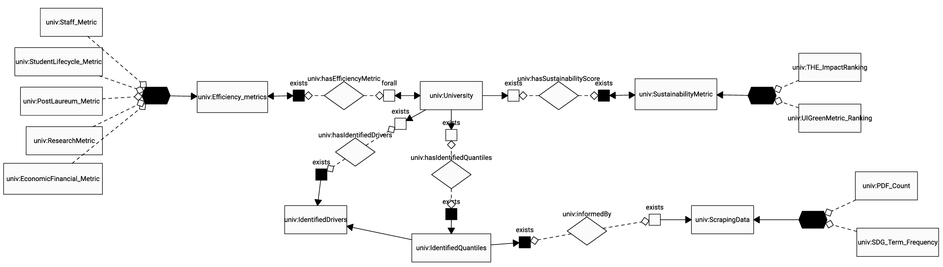
Ontological Model
The ontology acts as an integration layer
Efficiency Metrics
Sustainability Metrics
NLP Evidence
As we progress downwards our focus switches from quantitative to qualitative analysis
Notes:
The paper analyses the rise of global university rankings
Focus on metrics, performance measurement, and governance
Rankings part of wider changes in higher education
Linked to globalisation
Commercialisation of knowledge
Audit culture
Neoliberal policy ideas
Universities increasingly compared using numbers
Rankings influence behaviour of institutions
They are not neutral tools
They shape decisions and priorities
Rankings connected to global competition
Universities compete internationally
Main idea:
Rankings are part of a larger transformation of higher education

Slide 6
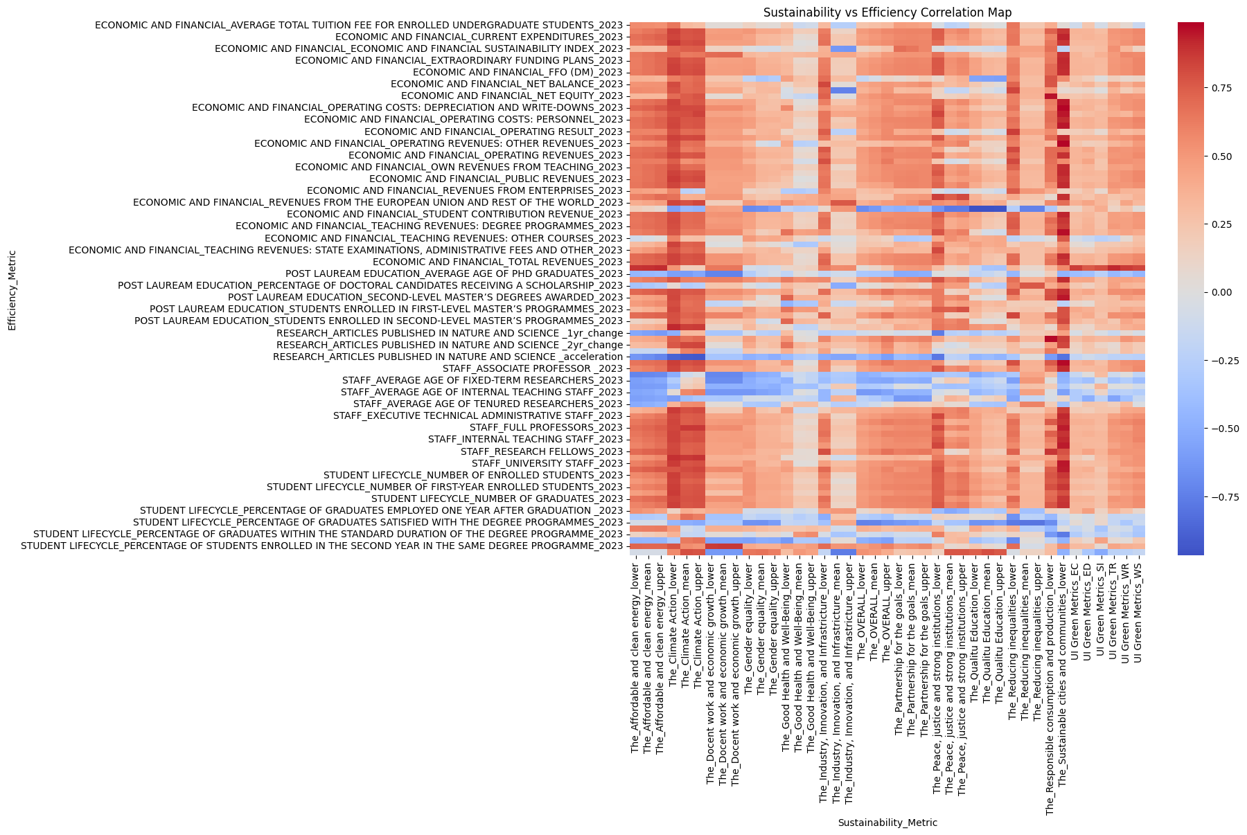
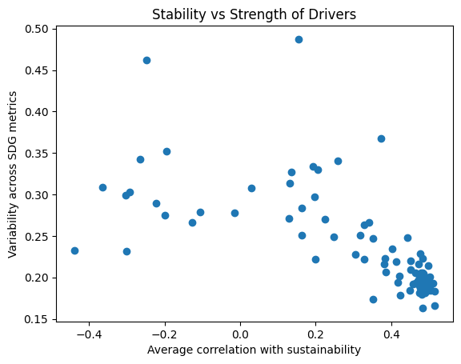
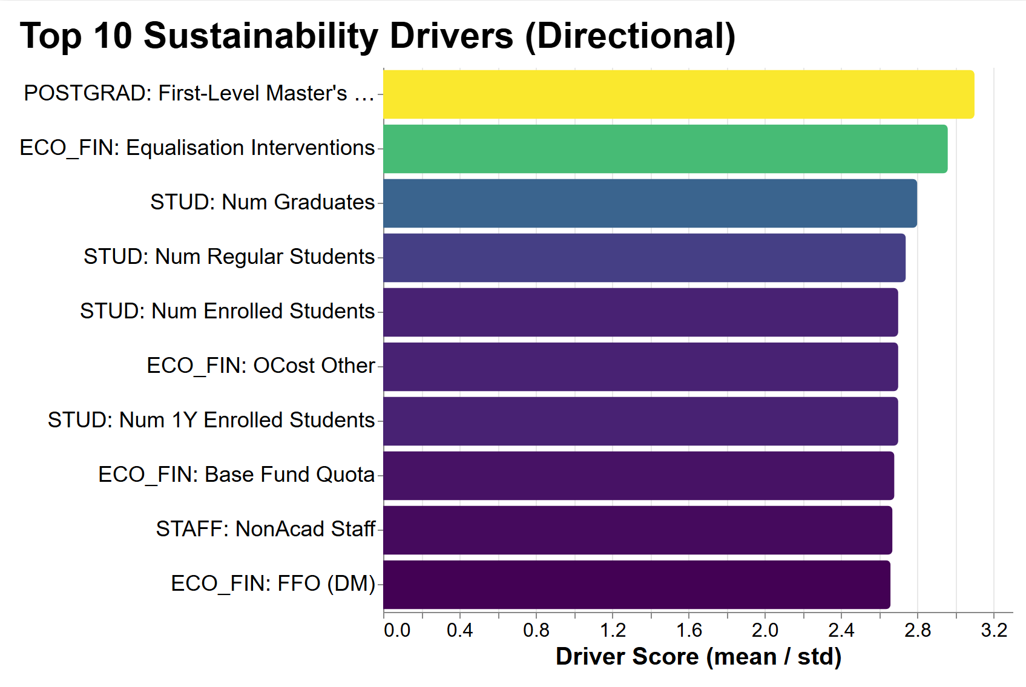
Quantitative Methodology
We chose to focus on a simple correlation analyis
Cross-Correlations
Sustainability Scores
Potential Drivers
Correlated Sapientia efficiency metrics with THE Impact Rankings and UI GreenMetric sustainability measures
Used Pearson cross-correlations to identify positive and negative relationships between efficiency and sustainability
Chose a simple correlation approach to keep results transparent and interpretable for qualitative analysis
Combined sustainability metrics from both THE SDGs and UI GreenMetric rankings
Calculated an overall sustainability score by averaging correlations across all sustainability dimensions
Used the mean-to-standard deviation ratio (μ/σ) to prioritise drivers with strong and consistent sustainability relationships
Identified the strongest positive and negative cross-drivers from the correlation results
Drivers represent institutional efficiency metrics that may influence sustainability performance
We will compare drivers across universities to explore how operational efficiency aligns with sustainability outcomes
Notes:
We intentionally used a simple Pearson correlation approach to keep the framework transparent and interpretable.
We correlated Sapientia efficiency metrics with THE SDG rankings and UI GreenMetric sustainability measures.
Then we created an overall sustainability score using the mean-to-standard deviation ratio — prioritising drivers that were both strong and consistent.
This allowed us to identify potential positive and negative “cross-drivers” between efficiency and sustainability.
The goal was not causal proof, but to generate interpretable institutional insights for the later qualitative analysis.

Slide 7
Web Scraper & NLP Pipeline
Using automated reporting analysis to contextualise quantitative sustainability findings
Webscraping Tool
NL Tool
Data Processing
University Base URLs
Filtering by Sustainability Keywords and Allowed URL Paths
SDG Detection and Thematic Analysis
Manual Sustainability Root Pages
CSV and JSON Outputs
Recursive Sustainability Crawl
Explore institutional sustainability transparency and communication
Extract sustainability evidence from webpages and PDF reports
Address the heterogeneity problem across reporting formats and terminology
Use NLP and word-frequency analysis to identify institutional narratives
Designed as an interpretive diagnostic tool - not a new ranking system
HTML and PDF Text Processing
PDF Discovery and Extraction
Notes:
We also developed an automated web-scraping and NLP pipeline to analyse sustainability communication across universities.
The scraper recursively explored sustainability-related webpages and PDF reports.
We extracted text from HTML pages and PDFs, then used keyword detection and word-frequency analysis.
This helped identify sustainability narratives, SDG themes, and reporting intensity across institutions.
Importantly, this was designed as an interpretive diagnostic tool — not a new ranking system.

Slide 8
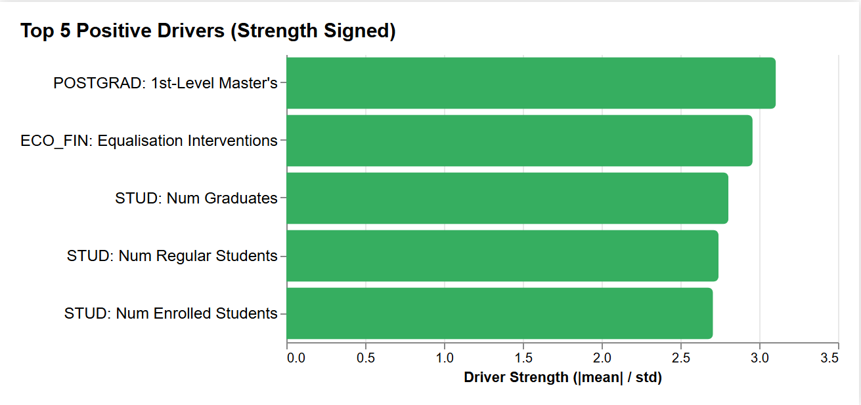
Strongest Potential Positive Drivers
All the top positive drivers show positive coefficients
The most significant potential driver is the prevalence of postgraduate first-level master's degrees
…followed closely by economic and financial equalisation interventions
Do high-performance cross-drivers imply an inherent correlation between sustainability and technical efficiency in higher education institutions (HEIs)?
Notes:
Governing by numbers has positives and negatives
Positive effects:
Transparency
Comparison between universities
Motivation to improve
Useful for students
Negative effects:
Oversimplification
Pressure to chase rankings
Less diversity
Focus on research not teaching
Competition culture
Universities may change priorities
Ranking position becomes goal
Quality may become secondary

Slide 9
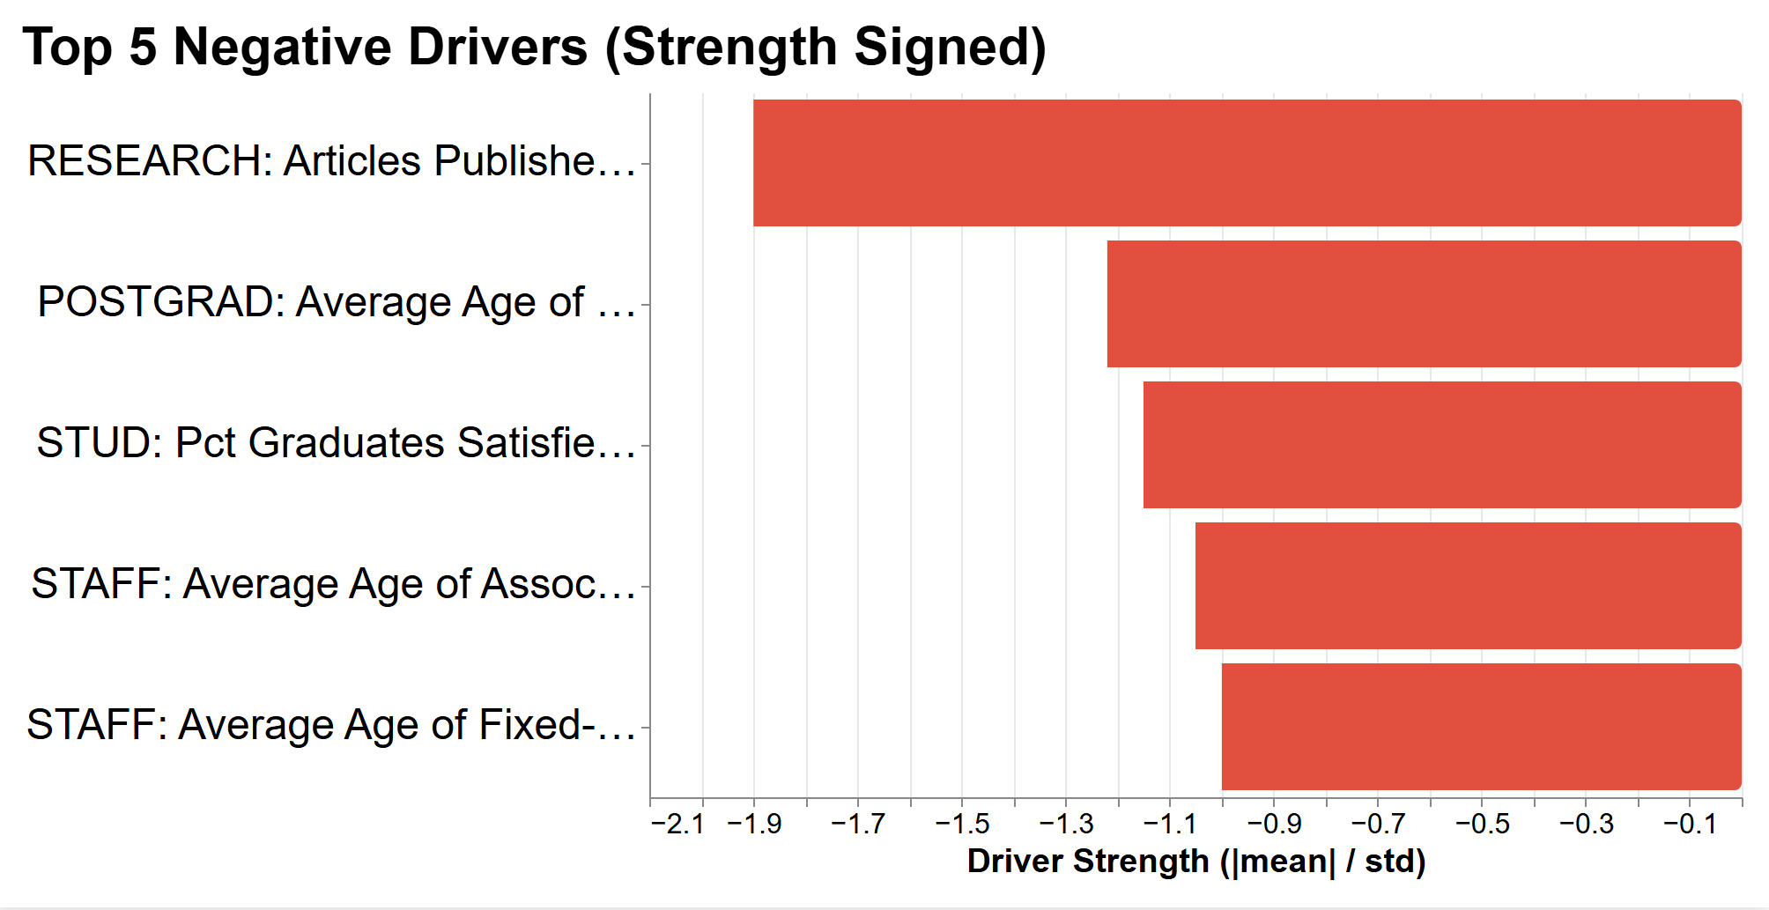
Strongest Potential Negative Drivers
Negative drivers showed higher variability
The number of articles published in Nature and Science has the strongest sustainability score by some distance in comparison to the 2nd strongest, the average age of PhD graduates
The sustainability scores begin to plateau, flattening beyond the 5th strongest
Could this suggest a trade-off between traditional research prestige and broader sustainability alignment within universities?
Notes:
Governing by numbers has positives and negatives
Positive effects:
Transparency
Comparison between universities
Motivation to improve
Useful for students
Negative effects:
Oversimplification
Pressure to chase rankings
Less diversity
Focus on research not teaching
Competition culture
Universities may change priorities
Ranking position becomes goal
Quality may become secondary

Slide 10
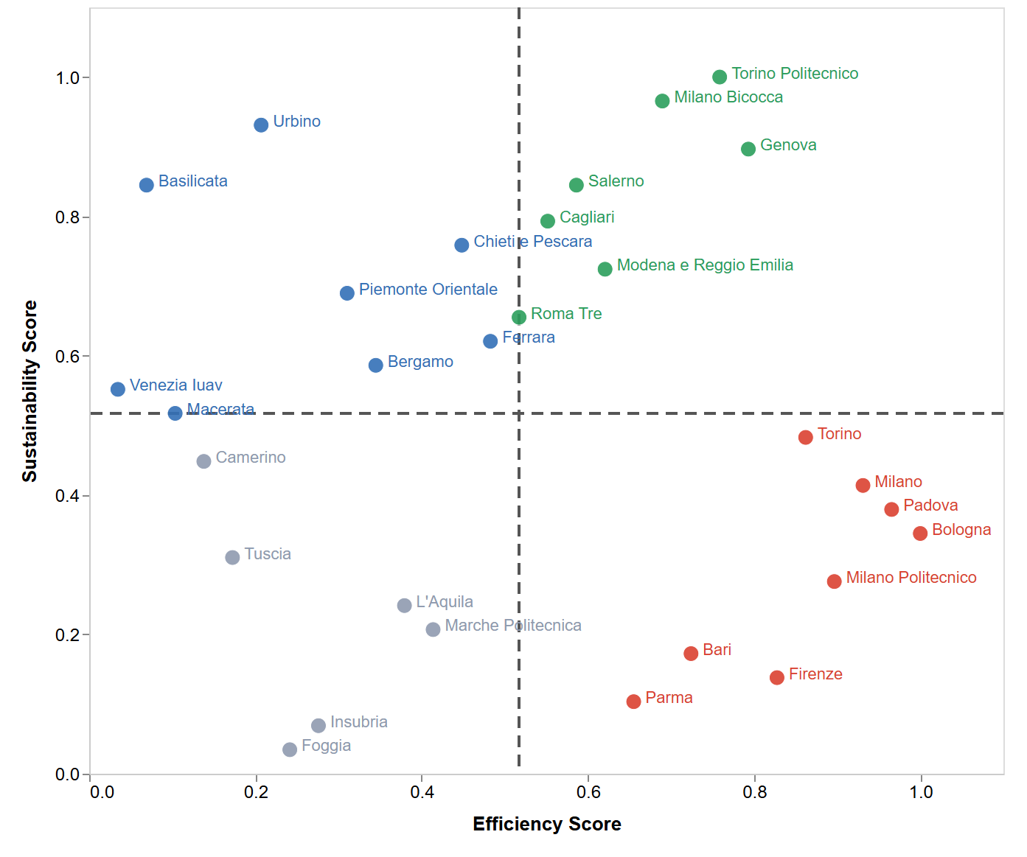
Efficiency vs Sustainability Matrix
Universities grouped by standardised efficiency and sustainability scores
Notes:
The universities are grouped into four categories according to their standardised Efficiency and Sustainability Scores.
This visualisation summarises the quantitative data to facilitate qualitative comparison.

Slide 11
Quadrant Interpretation
Bridging quantitative rankings with qualitative institutional behaviour
LEHS
HEHS
Strong operational performance alongside strong sustainability alignment
Sustainability appears integrated into governance, research, and institutional strategy
Often combines innovation, productivity, and visible ESG commitment
Lower technical efficiency but strong sustainability orientation and communication
Institutions appear more focused on governance, SDGs, and sustainability visibility
Demonstrates that sustainability performance is not solely dependent on scale or productivity
LELS
HELS
Operationally productive universities with weaker sustainability alignment
Strong traditional academic and research performance does not automatically translate into sustainability success
Suggests sustainability may be a lower institutional priority despite high capacity
Lower performance across both operational efficiency and sustainability measures
Sustainability communication and institutional integration appear weaker or fragmented
May reflect broader structural or resource-related challenges
Notes:
The paper analyses the rise of global university rankings
Focus on metrics, performance measurement, and governance
Rankings part of wider changes in higher education
Linked to globalisation
Commercialisation of knowledge
Audit culture
Neoliberal policy ideas
Universities increasingly compared using numbers
Rankings influence behaviour of institutions
They are not neutral tools
They shape decisions and priorities
Rankings connected to global competition
Universities compete internationally
Main idea:
Rankings are part of a larger transformation of higher education

Slide 12
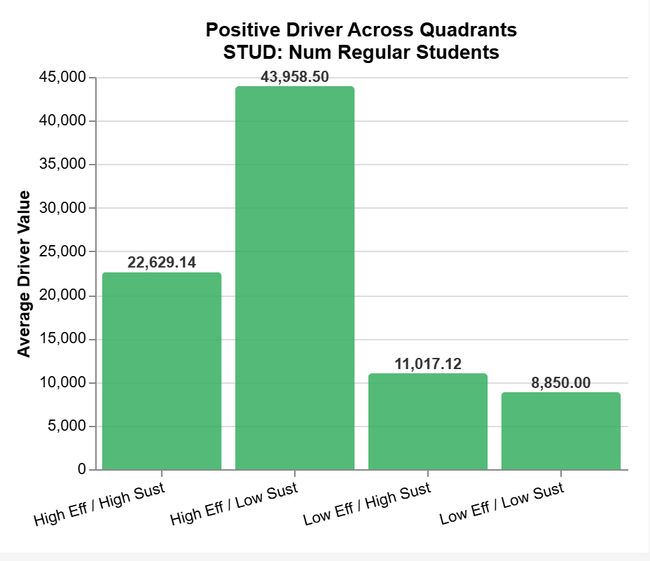
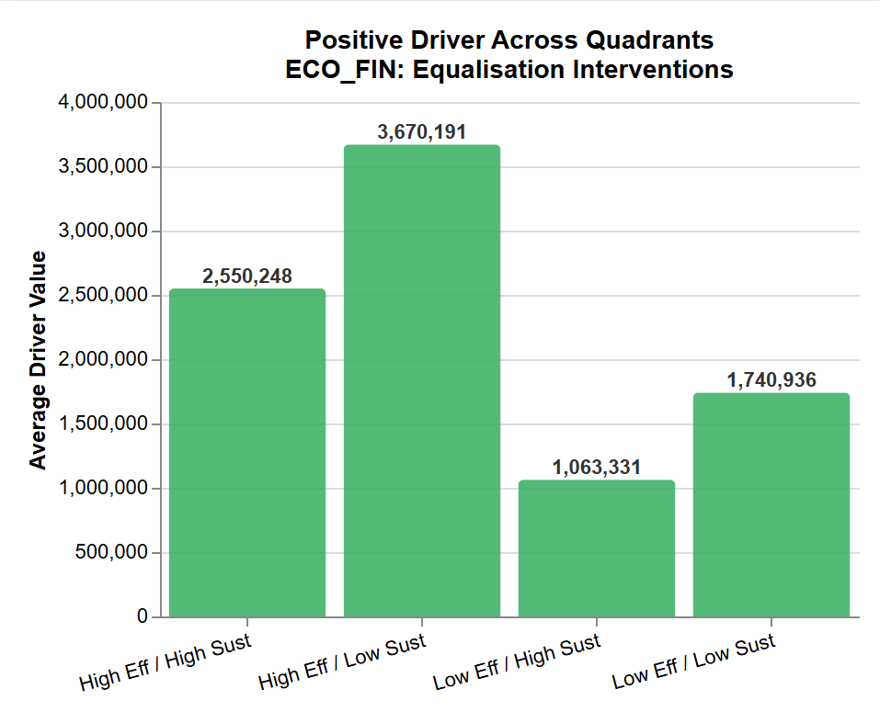
Quadrant Drivers (Positive)
HELS consistently recorded the strongest efficiency-related driver values
Some drivers may reflect institutional scale or funding structures more than sustainability orientation
LEHS and LELS did not maintain a consistent ordering across all drivers
Productive universities may prioritise research competitiveness over sustainability integration

Slide 13
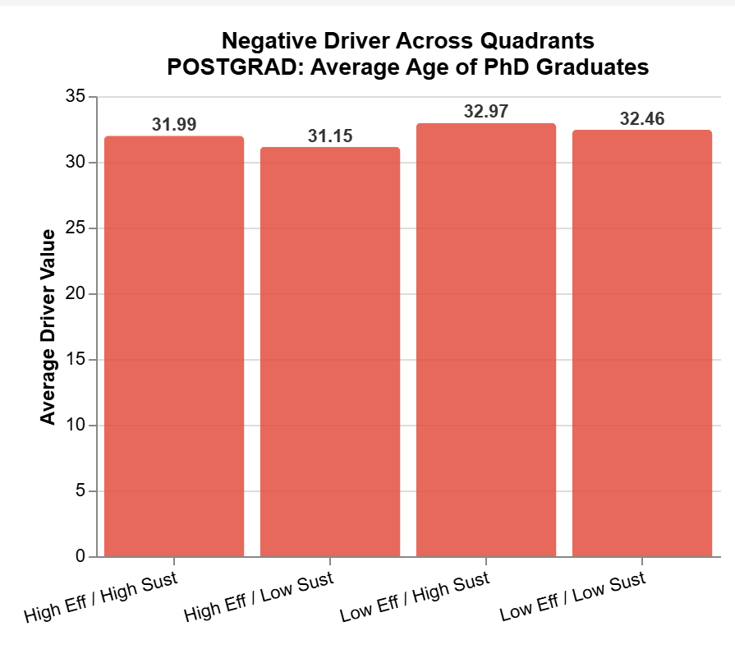
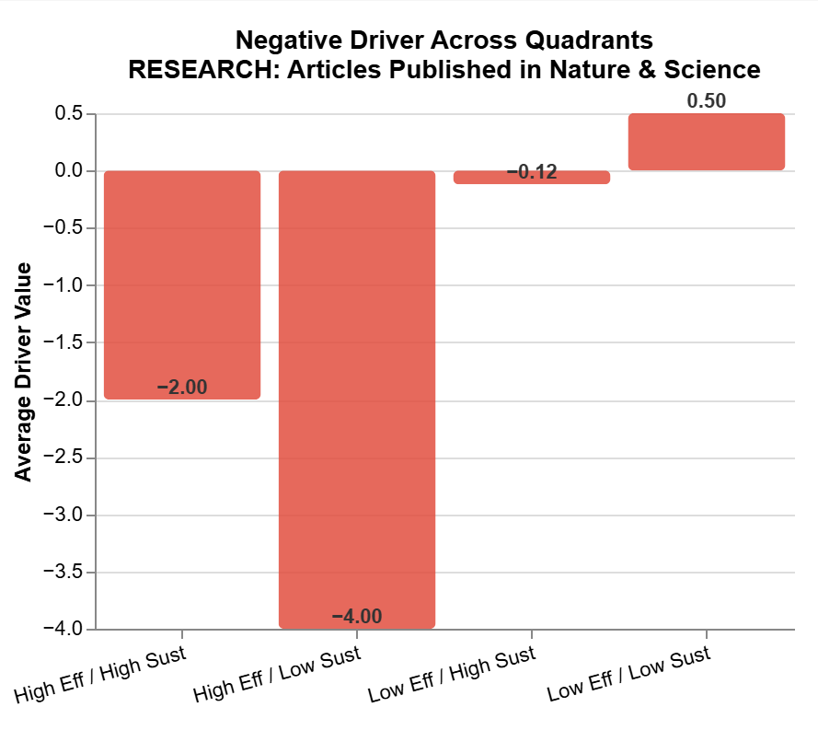
Quadrant Drivers (Negative)
Negative drivers showed weaker and less consistent quadrant separation
Most negative drivers displayed ambiguous or overlapping quadrant behaviour
Age-related drivers may reflect slower institutional adaptation and overlapping demographic effects
Nature and Science publications showed the clearest quadrant separation
Research-intensive institutions may prioritise academic competitiveness over sustainability integration

Slide 14
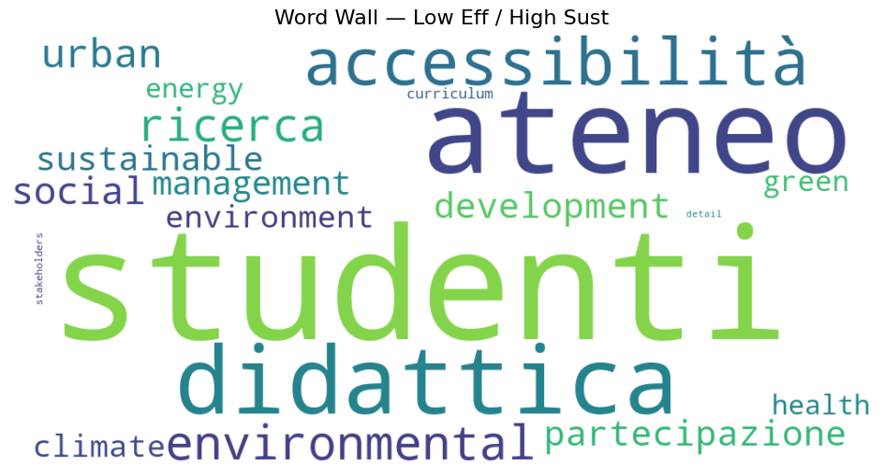
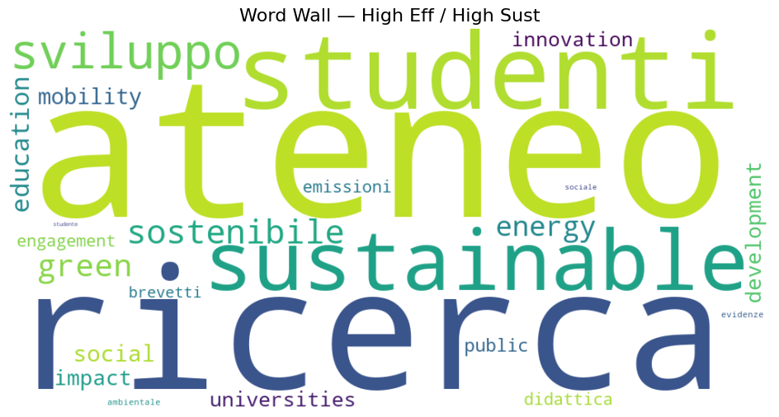
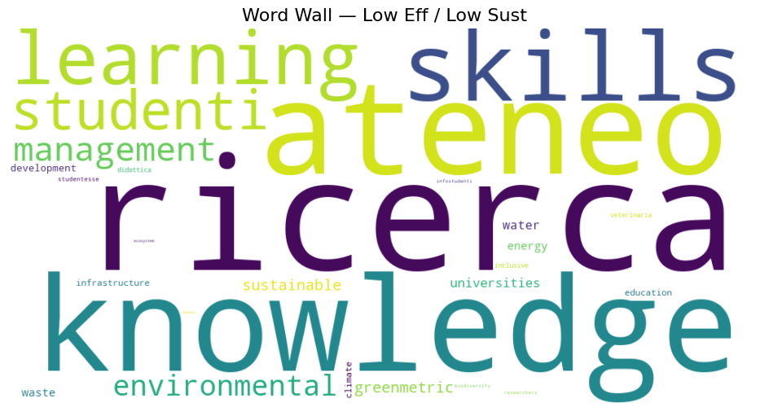
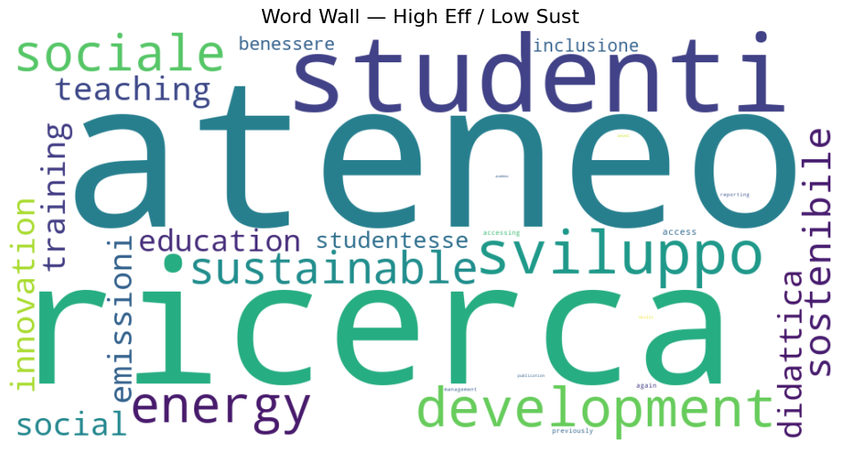
Qualitative Analysis of Sustainability Narratives
Comparing sustainability narratives across institutional quadrants
Notes:
HELS quadrants emphasised research, productivity, and institutional performance language
LEHS quadrants showed stronger environmental, accessibility, and social sustainability terminology
HEHS displayed a more balanced mix of innovation and sustainability discourse
LELS showed weaker and more fragmented sustainability narratives
Takeaway: Word frequency analysis provides interpretive evidence of institutional priorities — not direct proof of sustainability performance.

Slide 15
Key Contributions of the Framework
Subtitle here
Methodological Contribution Bridges quantitative rankings with qualitative institutional interpretation through an interpretable correlation-based framework.
Diagnostic Contribution
Introduces an efficiency-sustainability quadrant model to identify institutional behaviour and strategic positioning.
Technical Contribution
Integrates ontology modelling, NLP, and automated web scraping into a scalable mixed-method sustainability framework.
Notes:
Methodologically, the framework bridges quantitative rankings with qualitative institutional interpretation.
Diagnostically, the quadrant model helps identify different institutional sustainability behaviours and priorities.
Technically, we integrated ontology modelling, NLP, and automated web scraping into one mixed-method framework.
The framework is also scalable and could be extended to larger or multi-country datasets in future research.
Overall, the contribution is making sustainability analysis more interpretable and context-aware.

Slide 16
Limitations and Future Research
Exploratory framework with opportunities for further development
Limitations
Small sample size limited statistical generalisability
Correlations identify relationships, not causation
Web scraping depended on inconsistent university websites
Sustainability rankings contain methodological bias
Future Work
Expand framework to larger multi-country datasets
Apply semantic and transformer-based NLP models
Investigate institutional changes through longitudinal analysis
Incorporate causal inference and advanced modelling techniques
Notes:
The study is exploratory and limited by a relatively small sample of 29 universities.
Correlations identify relationships, but they do not prove causation.
Web scraping was affected by inconsistent university website structures and reporting quality.
Sustainability rankings themselves also contain methodological biases and differences.
Future work could expand the dataset internationally, apply transformer-based NLP models, and introduce longitudinal or causal analysis techniques.

Slide 17
Conclusion
Sustainability in HEIs is not just operational - it is also organisational, communicative, and governance-driven.
Efficiency ≠ Sustainability
High operational productivity does not automatically translate into strong sustainability alignment.
Framework Supports Interpretability
Correlation-based drivers and the quadrant model make quantitative data actionable for qualitative analysis
Qualitative Context Matters
Governance priorities, SDG narratives, and institutional communication shape sustainability outcomes beyond measurable outputs.
Thank you - Any questions?
Notes:
One of the main conclusions is that efficiency does not automatically equal sustainability.
Sustainability performance also depends on governance, communication, and institutional priorities.
The quadrant framework helps translate quantitative metrics into qualitative institutional interpretation.
We found that some lower-efficiency universities still demonstrated strong sustainability orientation and communication.
Overall, the framework shows how quantitative and qualitative approaches can be combined to better understand sustainability in higher education.

Slide 18
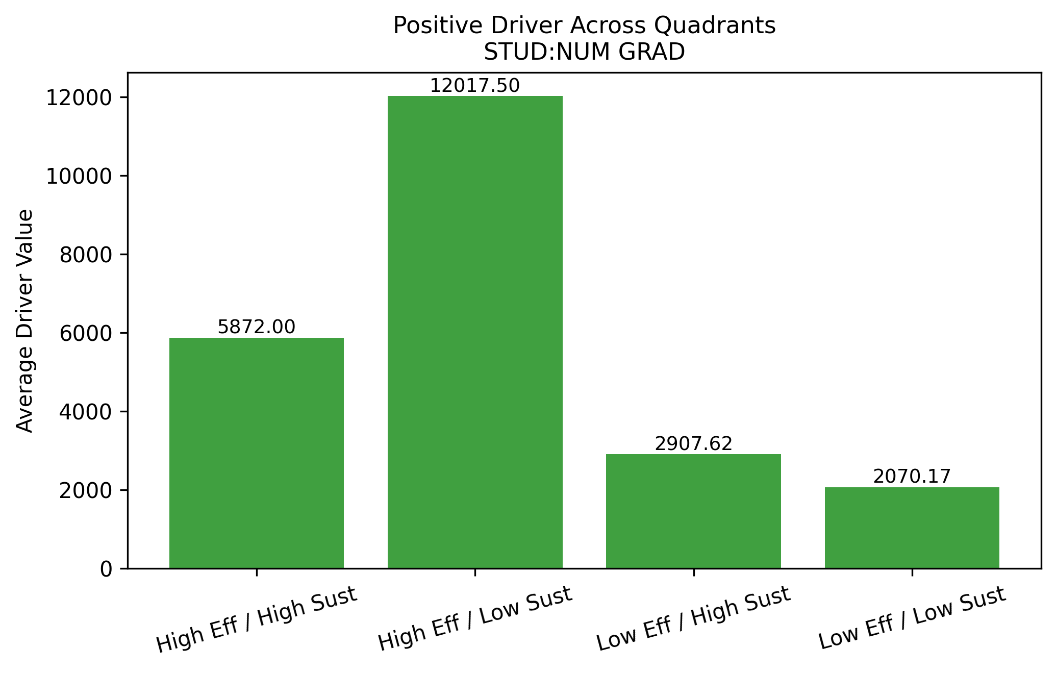
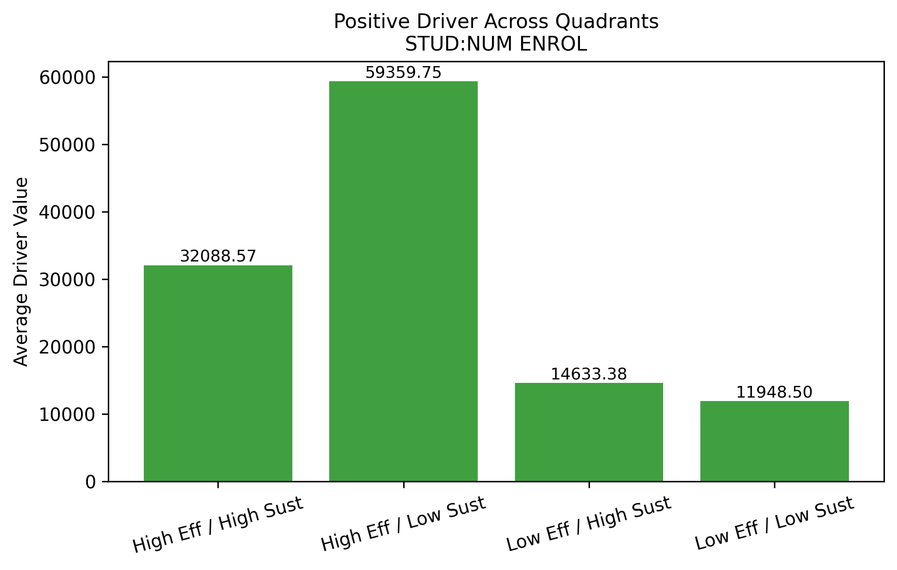
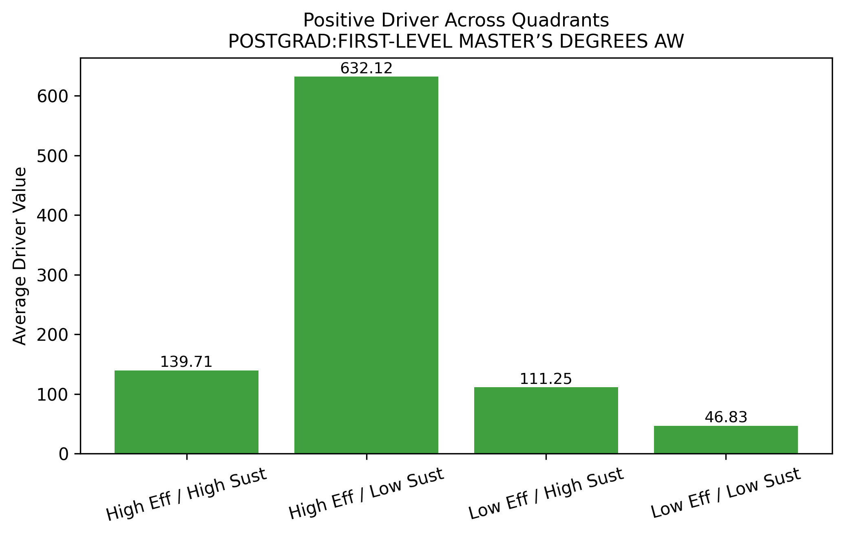
Appendix A
Quadrant behaviour on other positive drivers
Notes:
Rankings part of wider changes in higher education
Linked to globalisation
Commercialisation of knowledge
Audit culture
Neoliberal policy ideas
Universities increasingly compared using numbers
Rankings influence behaviour of institutions and global competition
Rankings are part of a larger transformation of higher education

Slide 19
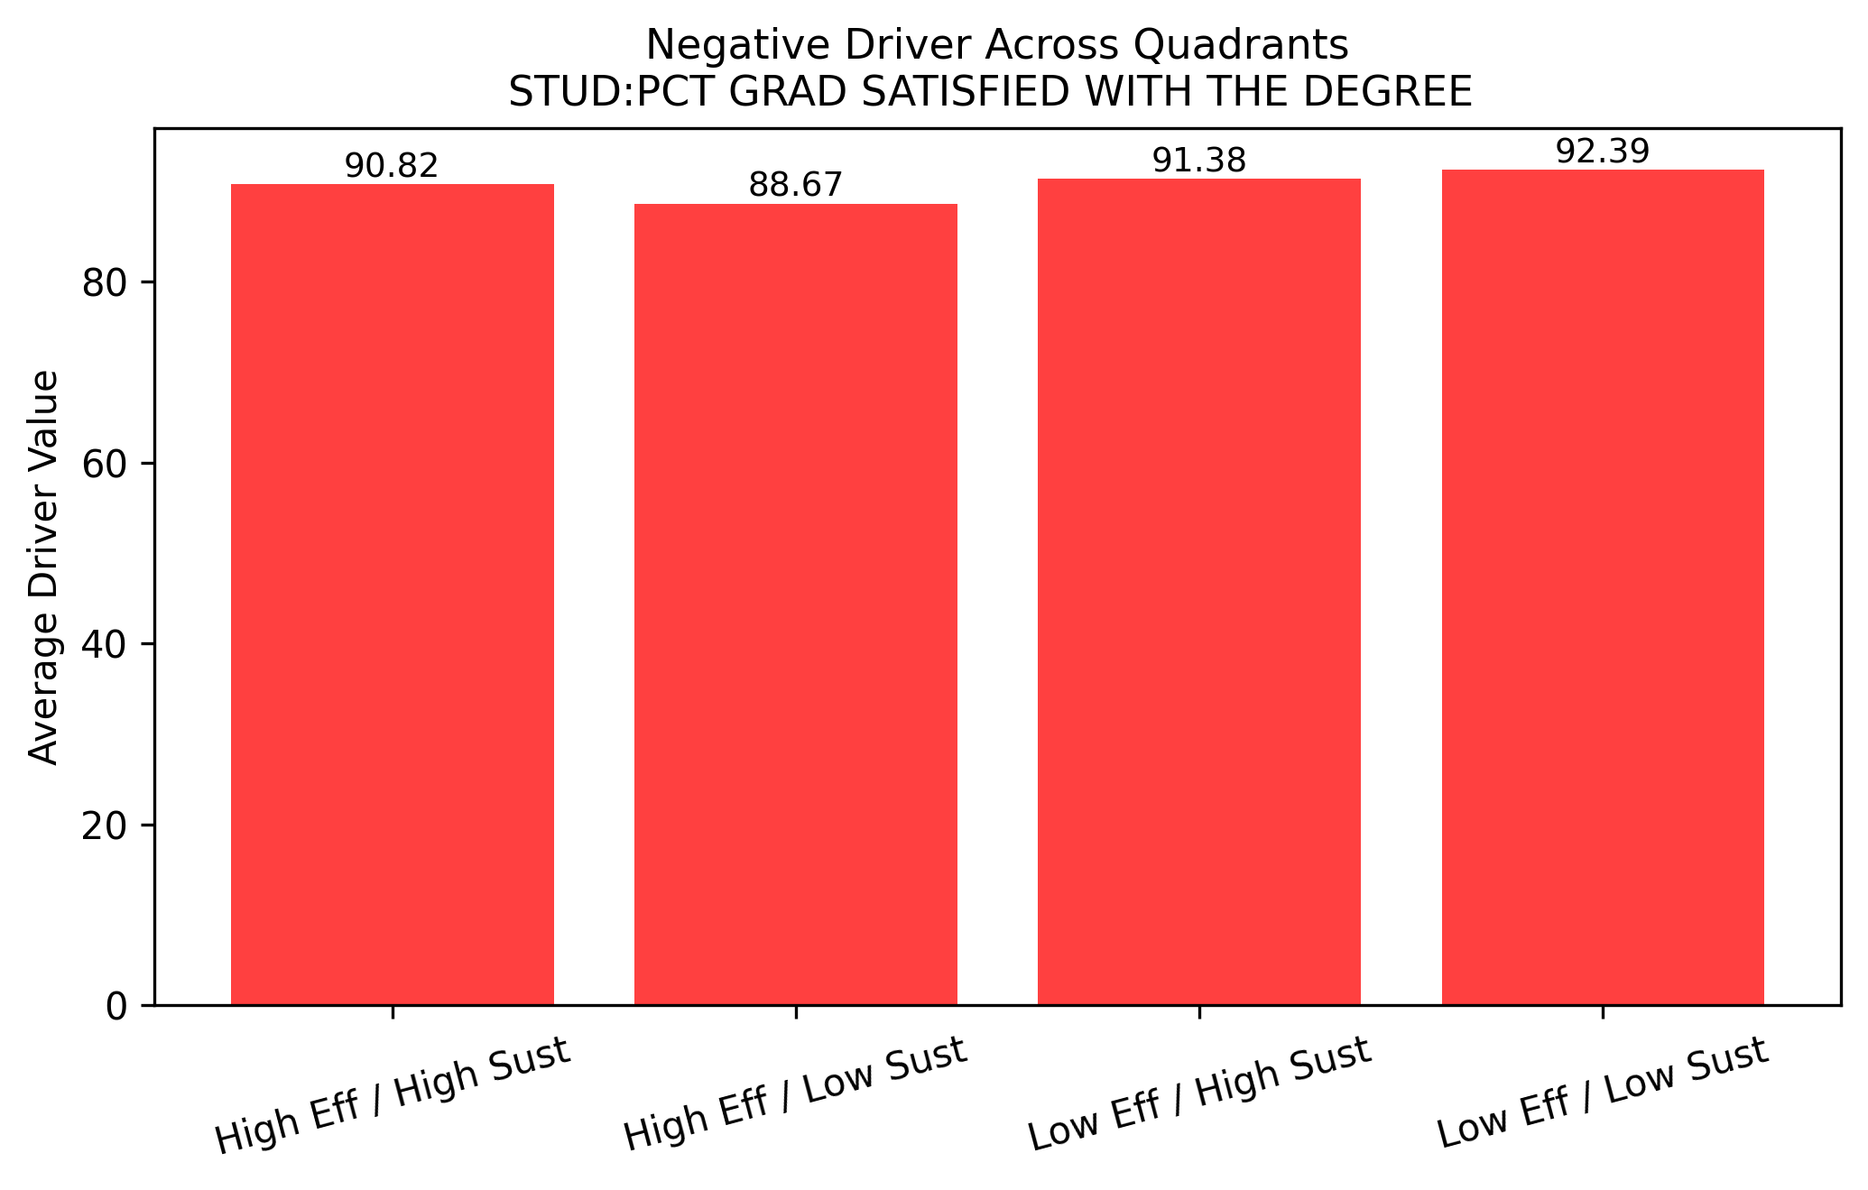
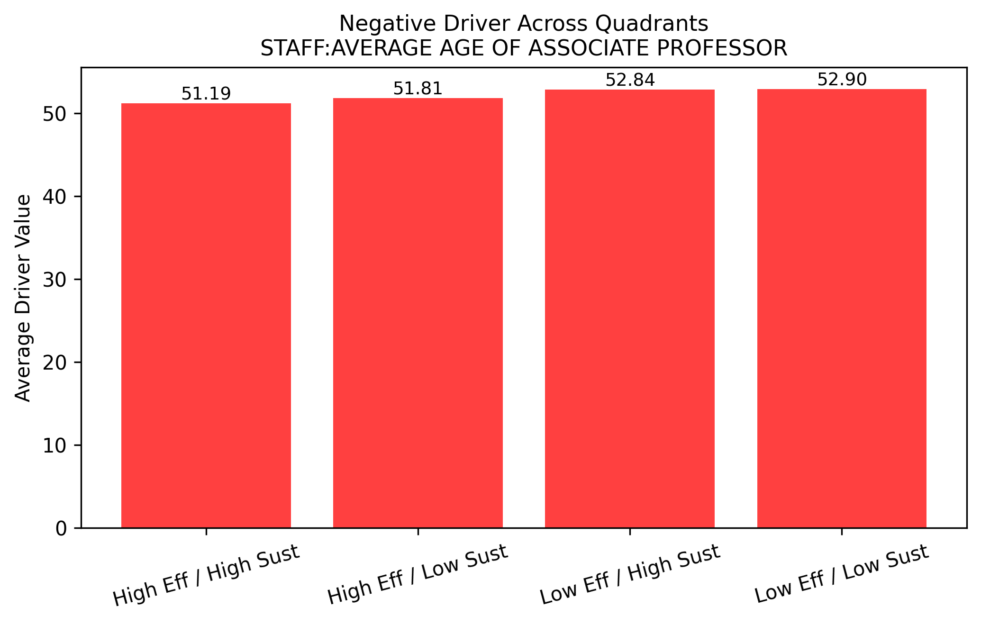
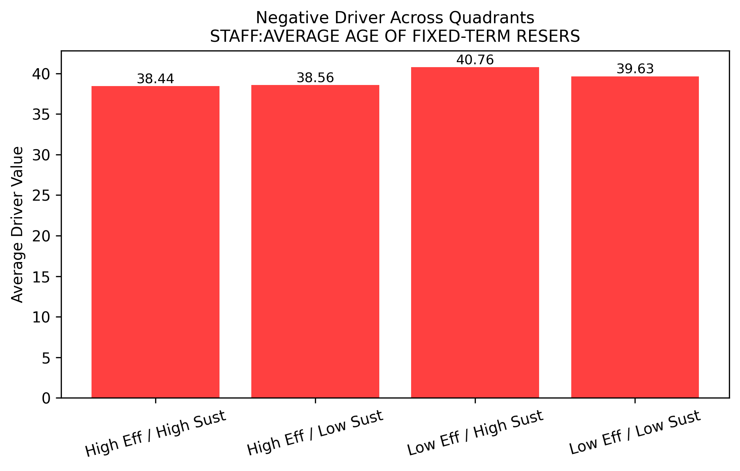
Appendix B
Quadrant behaviour on other negative drivers
Notes:
Rankings part of wider changes in higher education
Linked to globalisation
Commercialisation of knowledge
Audit culture
Neoliberal policy ideas
Universities increasingly compared using numbers
Rankings influence behaviour of institutions and global competition
Rankings are part of a larger transformation of higher education

Slide 20
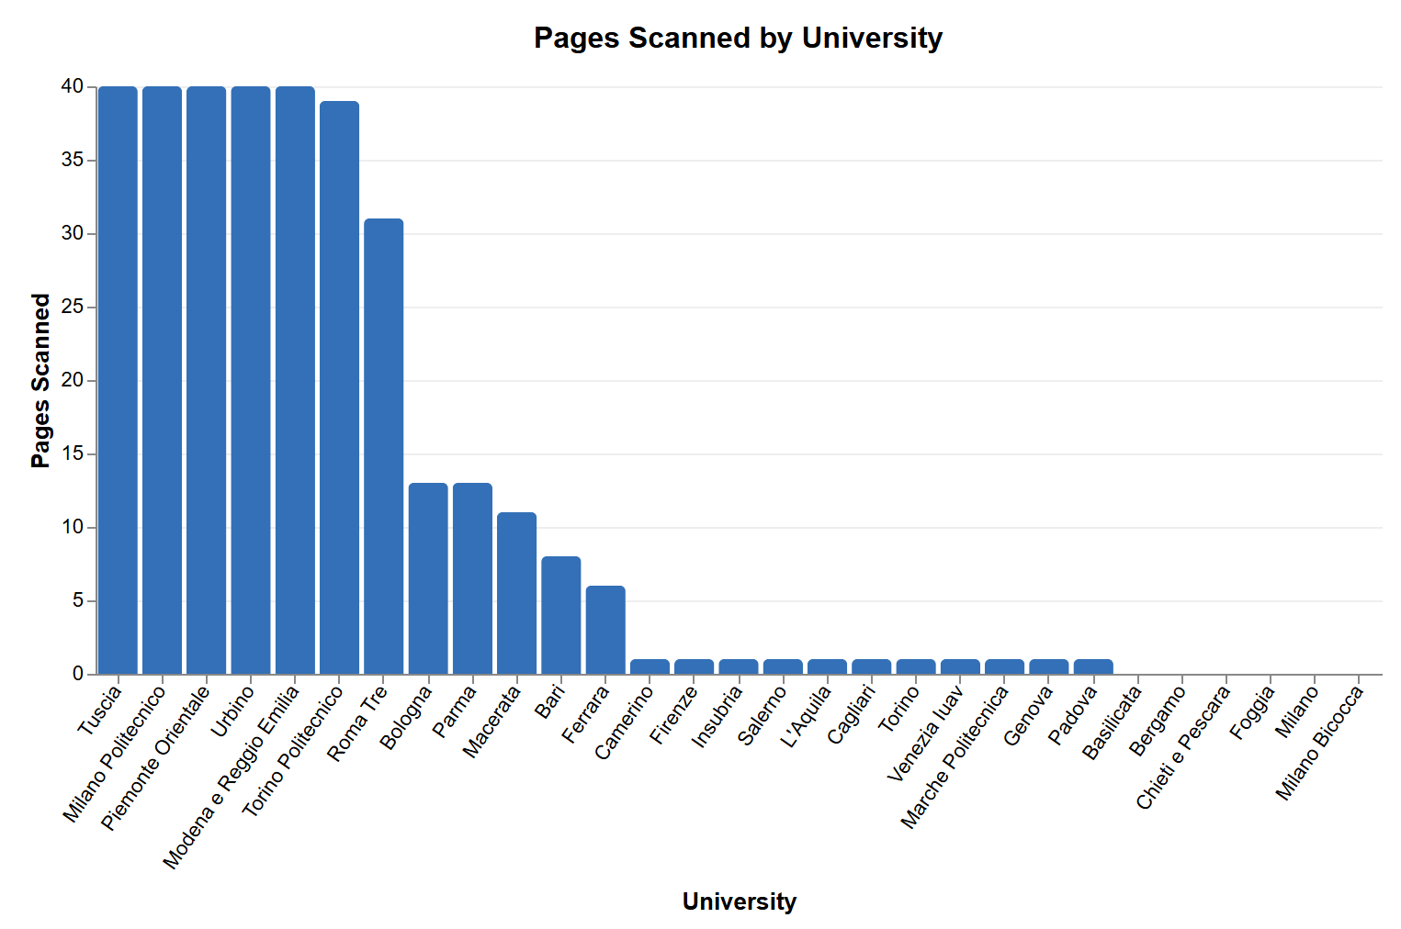
Appendix C
Documents identified via the webscraper
Notes:
Rankings part of wider changes in higher education
Linked to globalisation
Commercialisation of knowledge
Audit culture
Neoliberal policy ideas
Universities increasingly compared using numbers
Rankings influence behaviour of institutions and global competition
Rankings are part of a larger transformation of higher education

